Slide 1
Extinguisher Overview
GITHUB – Requires AGS “Analog System Test Developers”
2025 ww18 Pacheco, Miles
Release v4.4.1

Slide 2
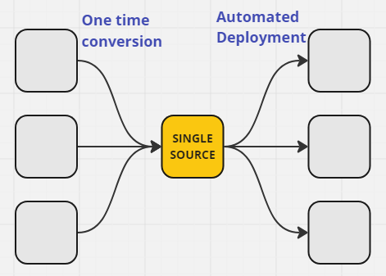
Torch Extinguisher Purpose
Take multiple modules configured “similarly” and merge them into single source.
Automate distribution of changes across modules.
Uses layers of modifications via python to manage output.
Many modification types were lifted from TPIE, but with enhanced features.

Slide 3
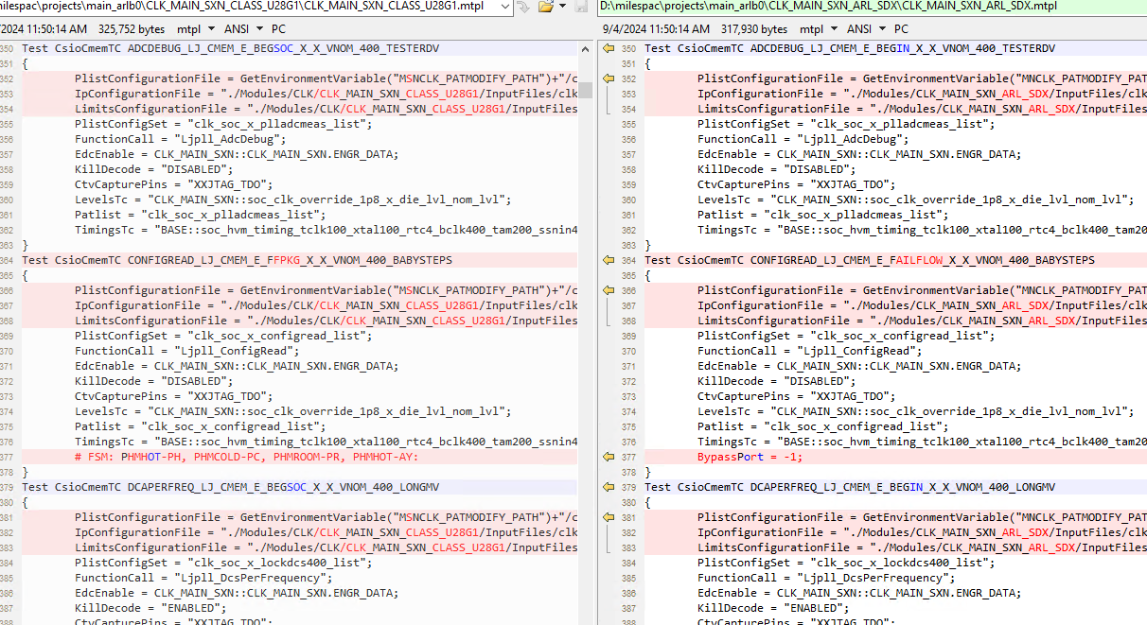
Basic Setup
Start with list of deltas between versions of the same modules.
Copy a module, and rename it <ModuleName>.input.mtpl.
Ideally a sort module, for bin/counter reasons.
Use the reference for modifications a guide to add “Rules” for each socket/product type/bom.

Slide 4

Benefits Gained
Once conversion is done, single source makes “global” changes much easier.
Leverage automation of bin/counters, instance removal, and Prime/TOS versioning.
Assists PDE to become more familiar with basic OTPL syntax, making debug easier.

Slide 5
Restrictions
Once an instance is defined, it exists for all output modules.
If a test is needed for only one output module, bypass un-needed segments.
Bin & Counter definition is required for all tests in CSV.
Common Configs are required for all modules.
For a given module, no BOMGroupName overlap.
At least 2 output modules are recommended. The more re-use across prod/bom/socket, the more benefit.
Not all usage models plumbed, only CLK and some MIO have used extinguisher.

Slide 6
Usage
Many modifications supported, and these are executed top to bottom.
Multiple layers of modifications is supported!
If you use mod1a to add in a @KILLRULE tag for mod5 for a particular OUTPUT, only that OUTPUT will contain the kill.
Input/Aleph can be shared among all modules in repo.
Common Terms this PPT:
“TEST” refers to the test definition, containing the name, template, and params.
“FLOW” refers to the flowitem definition, containing the flow name, routing, ports, etc.
“OUTPUT” refers to the output folders, typically socket/product/BOM.

Slide 7
Common Configurations (in config.json)
Special Case – top level key, see Slide 9
_ModuleFolderName (string)
Set based on config.json dictionary
Required
_BomGroupName (string)
Should match value from TP.
_CounterStandard (string)
“hbsbcntr” or “90hbcntr”
_BinStandard (string)
“hbsbcntr”, “90hbhbsb”, “90hbsbzz”
_FlowType (string)
determines kill port routing, “forceflow” or “stoponfail”
Optional Features
_TcgProduct (string)
this should match DRV root.
_PrimeVersion (string)
major version is enough
_TosVersion (string)
major version is enough
_AutoAlarms (boolean)
true if needed, per-instance alarm port
_EoLSwitch (boolean)
true if needed, usage of @EOL-REMOVE
_ModularBindef (boolean)
true if needed, _TosVersion is required.
_ModularEnv (boolean)
true if needed, _Idrive and _SubmoduleFolder are required.
_Idrive (string)
netapp mapping to pattern patch I:, only needed when using Modular Env.
_SubmoduleFolder (string)
name of folder in TP/Modules folder, if using submodule in TP; only needed when using Modular Env.

Slide 8
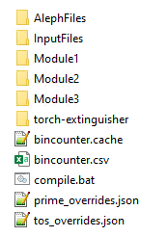
Directory Setup – .source folder
There is a quickstart.bat file in the script repo that can set these files up for you.
Inside the .source folder:
local copy of torch extinguisher
Module folder (named to match TestPlan name – “true” module name)
InputFiles folder with all files for all modules.
AlephFiles folder with all files for all modules.
Compile.bat script to generate OUTPUT folders.
Mod 4 / 11 collateral

Slide 9
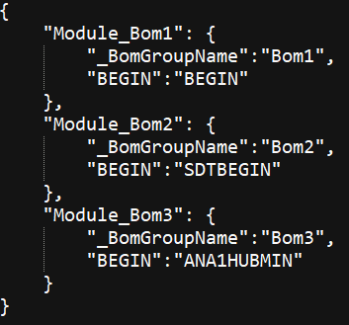
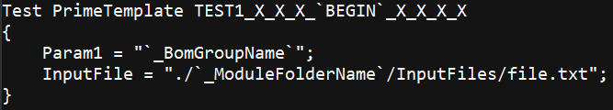

Modification #1a – Variable direct text replacement
`VAR` - backtick not quote
Uses the “config.json” file in directory.
For a chunk of text that needs to be variable, this will search/replace each instance.
Format is `VAR`, where VAR exists in config.json for every OUTPUT.

Slide 10
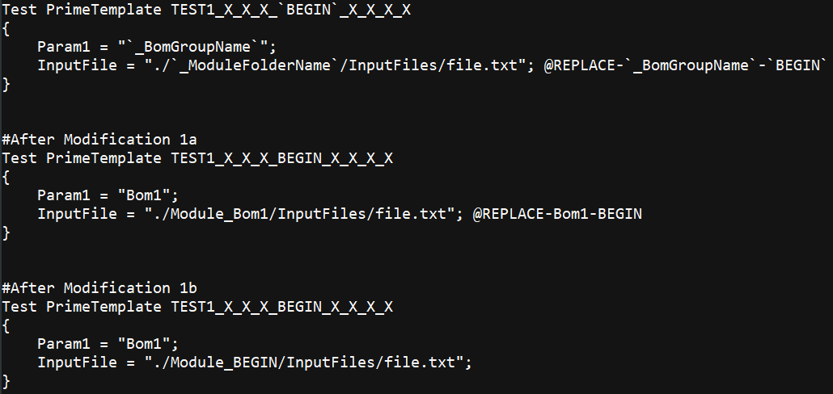

Modification #1b – Param text replacement
@REPLACE-<SEARCH>-<REPLACE>
An additional layer of text replacement, but takes place after Modification 1a.
Likely only needed in corner cases, makes layering of additional search/replace easier.

Slide 11
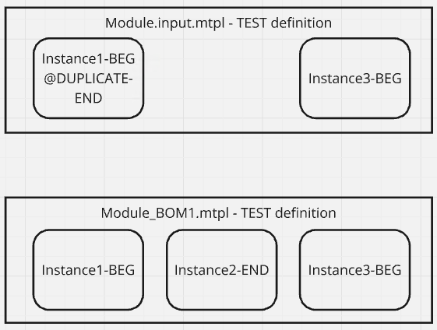
Modification #2 – Duplicate Test
@DUPLICATE-<new subflow>
Targeting an individual TEST only, will create a copy with a different subflow name.
Primary usage for duplicating to failflow, or between BEGIN/END/etc.
Today no way to modify params, only subflow name.

Slide 12
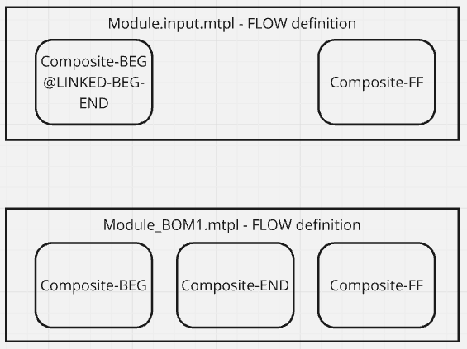
Modification #3 – Linked Flow
@LINKED-<OLD SUBFLOW>-<NEW SUBFLOW>
Targeting composites only, create a copy with a different subflow name.
Primary usage for duplicating to failflow, or between BEGIN/END/etc.
Today no way to modify bin, counters, or kills - only subflow name.

Slide 13
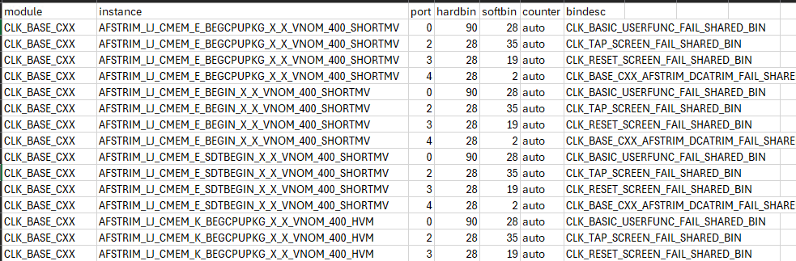
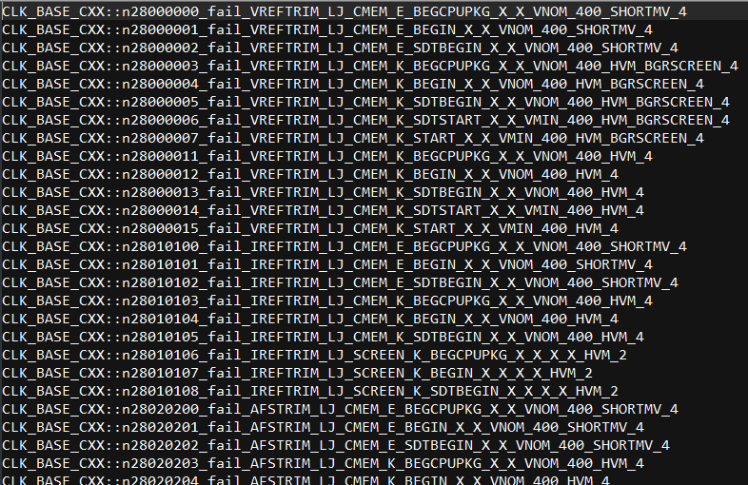
Modification #4 – Bin / Counter Automation
Leverage the CSV and cache in the /.source/ folder.
Enforces the following:
All TESTS are defined (for every OUTPUT)
Can use _AutoAlarms for automated “per-port” alarm bincounters.

Slide 14
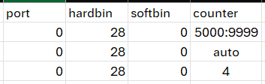
Modification #4 – Bin / Counter Automation
FYI for Bincounter CSV:
Module, Instance, Port will auto-populate upon detection from MTPL. Hardbin and Softbin are required.
Counter can be an exact number, “auto” to generate any counter between 0-9999, or a range M:N.
Range will act as “auto”, but enforce generation within M to N range.
Auto is best used in cases where hardbin + softbin are not shared with any other team.
Range is best used in cases where hardbin + softbin is shared with another team.
Leading zeroes are not required.

Slide 15
Modification #4 – Bin / Counter Automation
Additional Notes:
Script will take care that OUTPUT is formatted to match binning standard.
Description can be used to override the default (Module::Instance_Port)
Pre-existing counters to be avoided can be added to .cache file manually.
Additional Notes:
When a test is detected that doesn’t contain bin/counter info, the script will error and ask for this information.
Each unique OUTPUT instance name requires unique value. BEGIN and SDTBEGIN need diff vals.

Slide 16
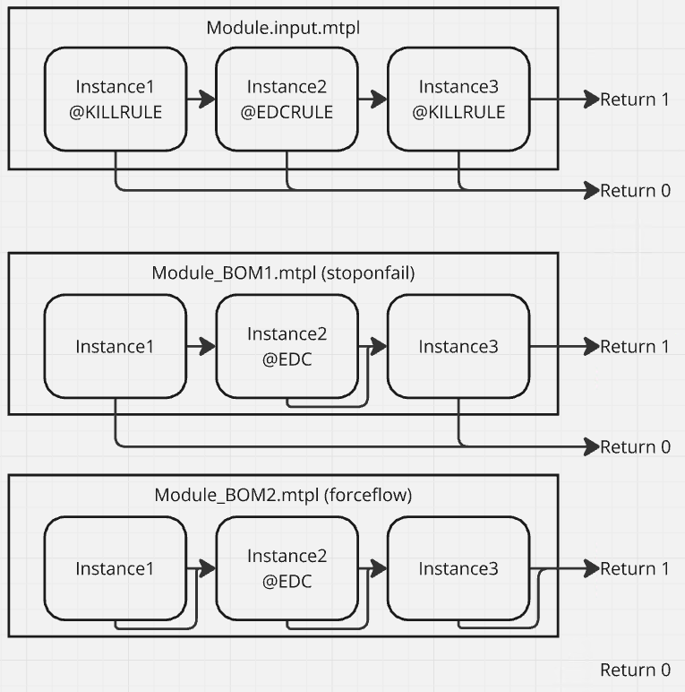
Modification #5 – Kill/EDC Rules
Four tags can be leveraged on the FLOW line;
@EDC
@KILL
@EDCRULE
@KILLRULE.
@EDC is a torch-supported tag, will visually be represented in VS & TRACE. This option enforces no bins
@KILL will only enforce bins, and is not required but recommended.

Slide 17
Modification #5 – Kill/EDC Rules
@EDCRULE will force the instance into EDC and will “snap” all non-alarm fail ports to the port 1 routing.
@KILLRULE will enforce bins and enforce forceflow / stop-on-fail flow routing.
Please initially connect failports to the “stop-on-fail” option (typically Return 0) if you wish to use these options.

Slide 18
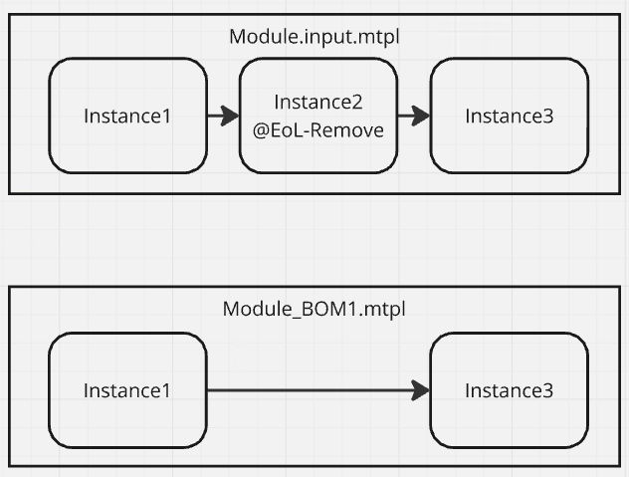
Modification #6 – EoL Test/Flow Removal
@EOL-REMOVE can be added to both TEST and FLOW items.
This tag will delete the entity for given OUTPUT.
FLOW removal will attempt to re-route deleted items, based on removed tests’ connection
“_EoLSwitch” key must be true in config.json, configurable per OUTPUT.

Slide 19
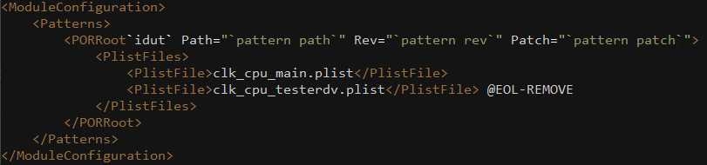
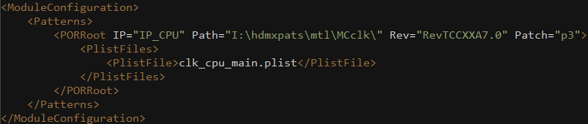
Modification #7/8 – FLW and MCONFIG
<ModuleName>.input.flw and module.input.mconfig should be defined in Module folder.
These two files are treated specially; they support both Mod1a and Mod6.
FLW will auto-remove @ EoLRemove items from the MTPL but can support additional items as well.
For mconfig, @EoLRemove will delete an entire line. Intention is to remove an entire (testerdv) plist file.

Slide 20
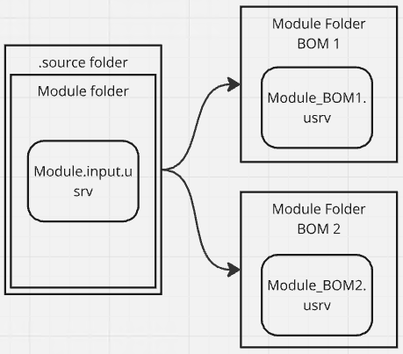
Modification #9 – Merged Collateral Files
If you add .input. to a file name inside the module directory, we will run Mod1a rules on that file.
Additionally the naming of that file in OUTPUT will follow the format: <MTPLName>.<extension>

Slide 21
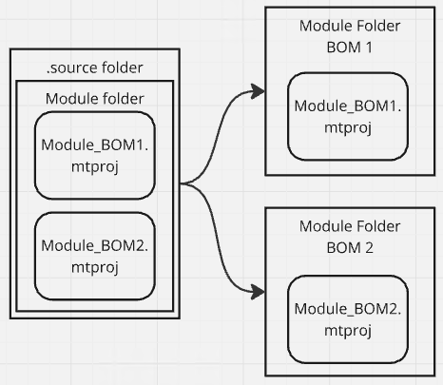
Modification #10 – Copy related TP files
Non-input files in the module directory (tcg, usrv, etc) are copied to the OUTPUT.
If there is BOM or TCG in the file name, only the matching config is copied.

Slide 22
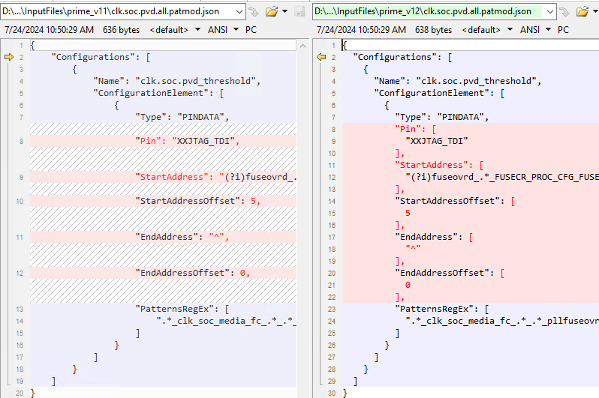
Modification #11a – Prime input files
Input/Aleph deltas are managed using separate files in subfolders named for the prime version.
Only input files in the matching version number are copied to OUTPUT.
Version number does not need to be full semantic, major rev is sufficient (so far).

Slide 23
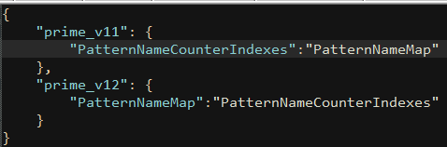
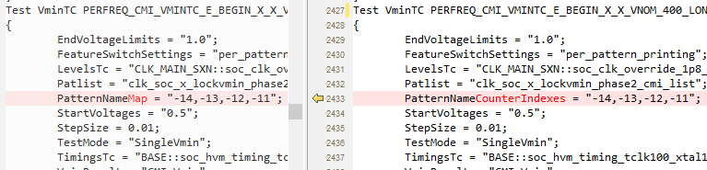
Modification #11b – Prime / TOS overrides
MTPL deltas use Regex based override.json in the .source folder which define search / replace pairs.
These overrides should only be used where multiple code versions are supported at the same time.
Once all OUTPUT are on the same version, update module to the new method and remove overrides.

Slide 24
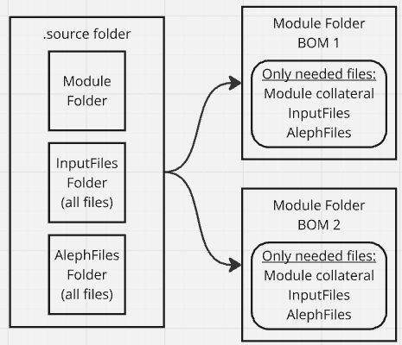
Modification #12 – Copy InputFiles/AlephFiles
Only files that are used in the MTPL are copied.
Similar to Mod10, we will go through all the InputFiles and AlephFiles subfolders, and will copy over all files to the OUTPUT.
If TCG or BOM are found in the file name, only the file with the matching value will be copied to OUTPUT.

Slide 25
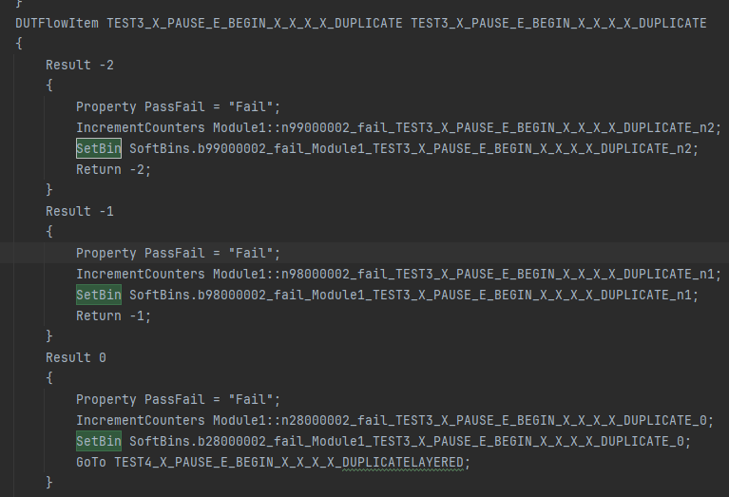
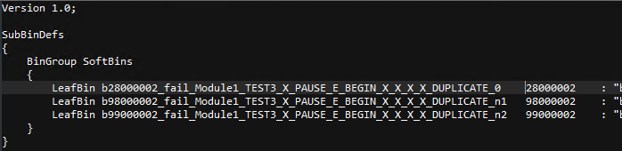
Modification #13 – Modular Bindef
When enabled, prints a sub-bindef based on the SetBin’s for each OUTPUT.
Some TP care is needed; can’t have mismatches, and importing sbdef is needed.
Support TOS 3 and 4 bdef
“_ModularBindef” key must be true, and “_TosVersion” is required.

Slide 26
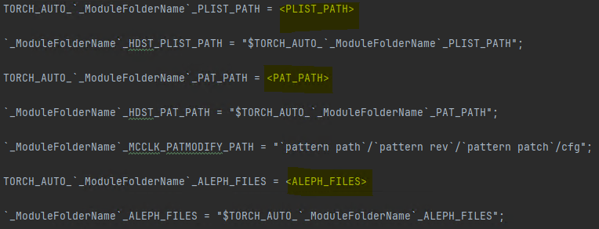
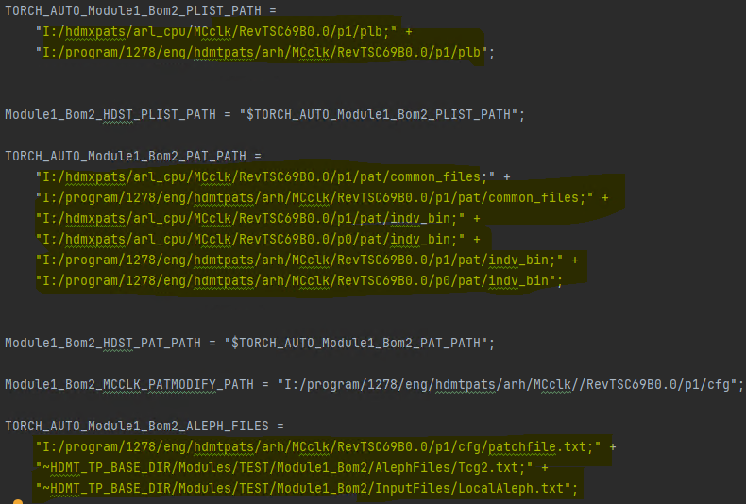
Modification #14 – Modular Environment File
<Module>_Envfile.input.env
.input.env file supports Mod1a to search/replace basic strings.
Set TORCH_AUTO paths to exact strings defined in yellow ->
Will read the I:\ drive pattern patch env.env files for PLIST and PAT, ALEPH from mconfig
Initial EnvFile.env can be generated w/TORCH if needed.
“_ModularEnv” key should be true, “_Idrive” key must be the netapp path, and “_SubmoduleFolder” set to module repo folder in TP.

